Slide 1
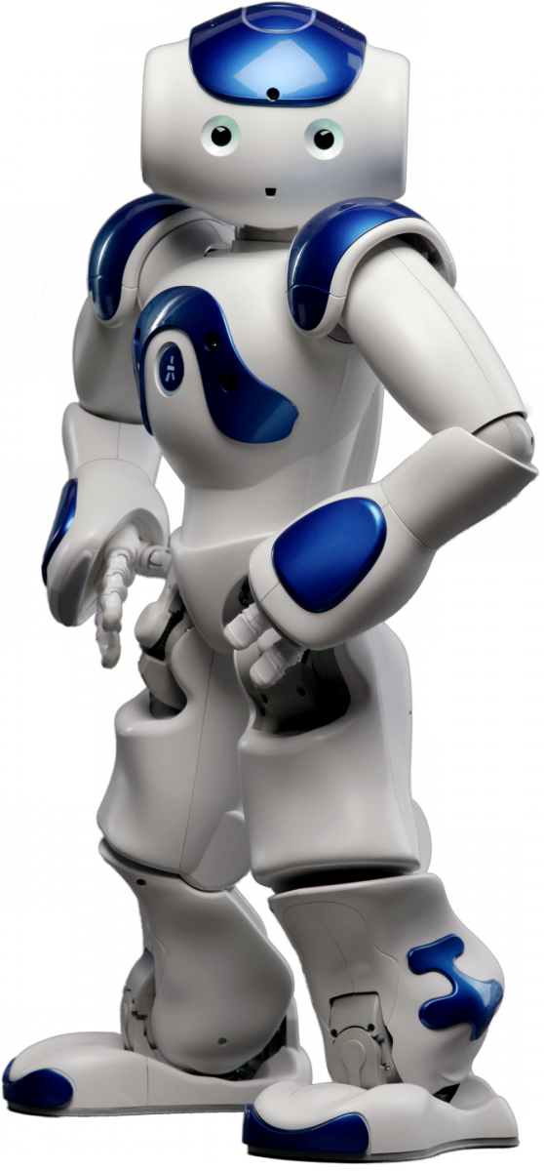
Altran
NAO Hackathon
June 1st and 2nd 2018

Slide 2
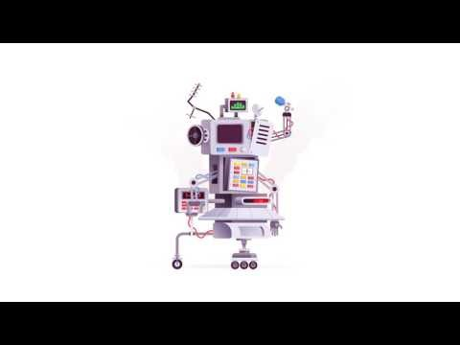
NAO Intro

Slide 3
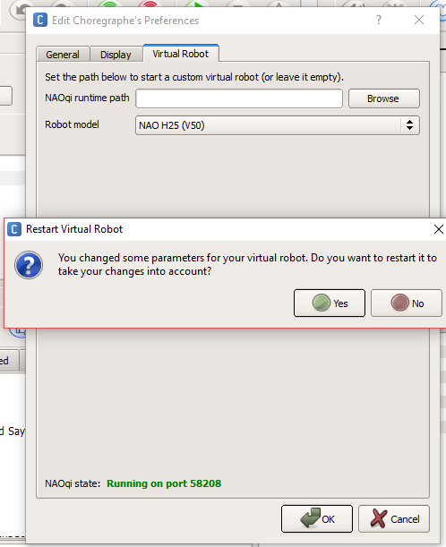
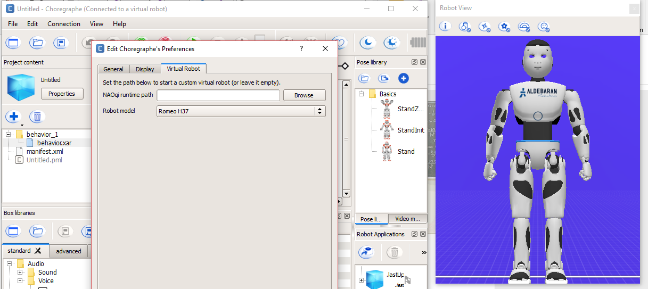
The Hacking tools
Tools\Choregraphe suite
For Linux, Mac and Windows

Slide 4
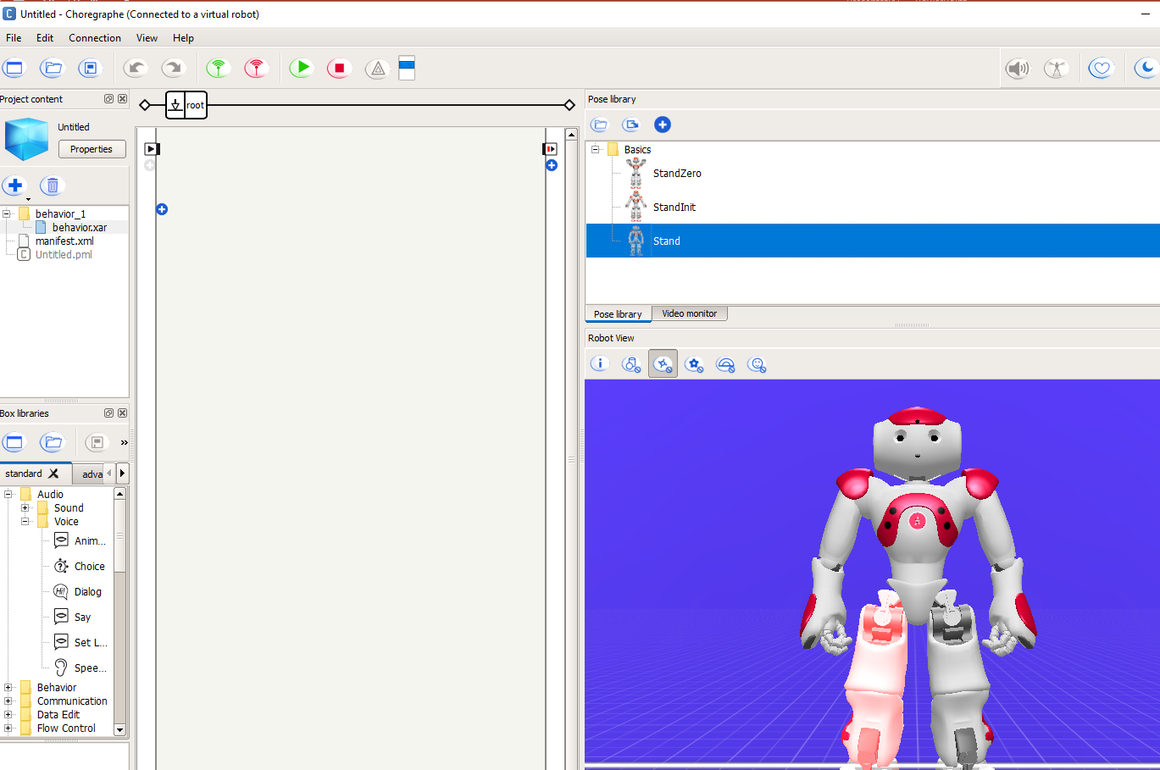
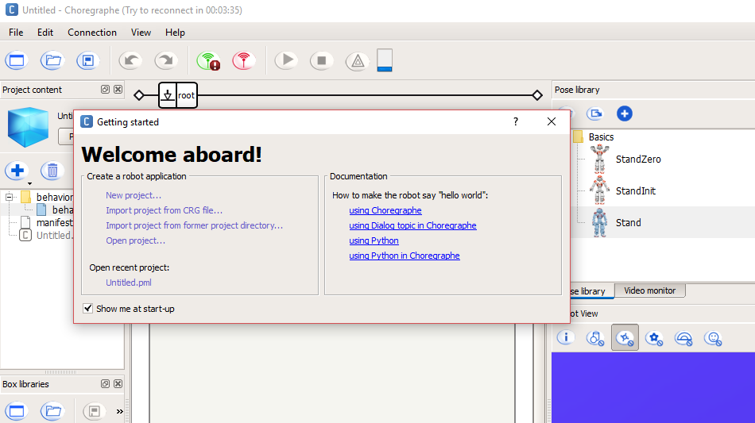
Choregraphe
Start with Hello World
Help → Getting started… → using Choregraphe

Slide 5
NAO Information
NAO Documentation http://doc.aldebaran.com/2-1/home_nao.html
Choregraphe User Guide http://doc.aldebaran.com/2-1/software/choregraphe/index.html
Choregraphe Tutorials http://doc.aldebaran.com/2-1/software/choregraphe/tutos/index.html

Slide 6
Questions? NAO Core Team:
NAO (nao1.nl@altran.com) Ralf Bus Hans Roggeveen Harm Wouters Richard van Santen

